Slide 1

Robotics & Microcontrollers

Slide 2
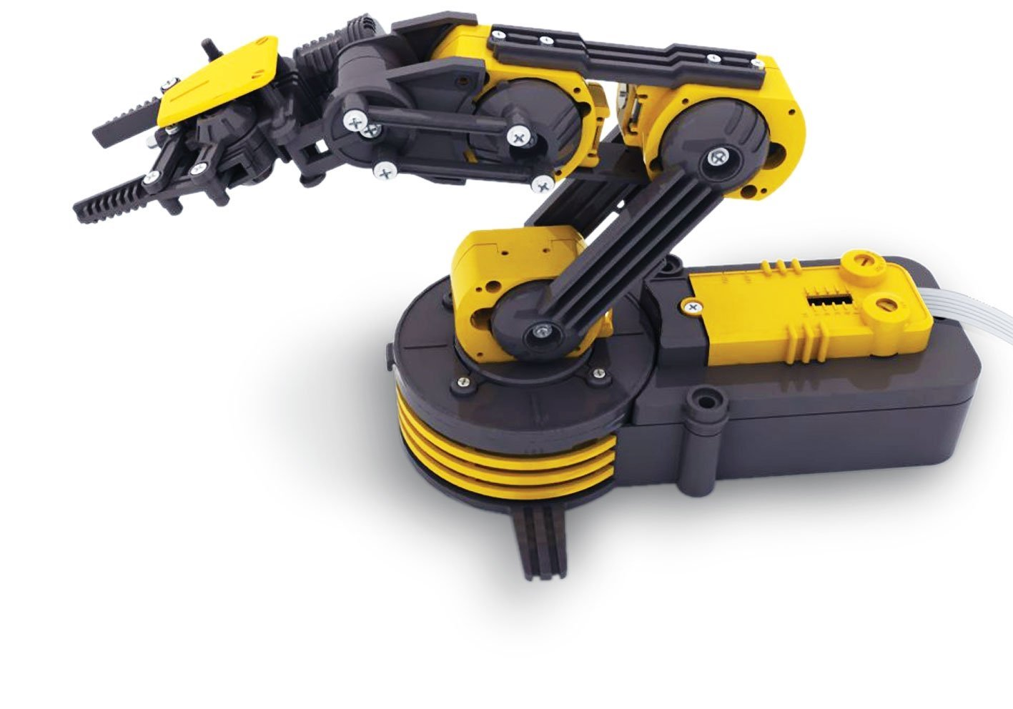
The School Robot Arm
Contains five rotary motors that control each of the joints.
Uses gears and linkages to translate the motors rotary motion to the final result.
The motors are connected to a circuit board, called a microcontroller that is able to supply, and switch the direction of, the voltage going to the motors.
The microcontroller accepts instructions over USB allowing us to use programming to move the arm.

Slide 3
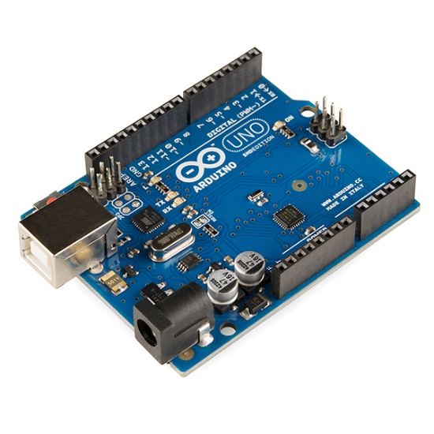
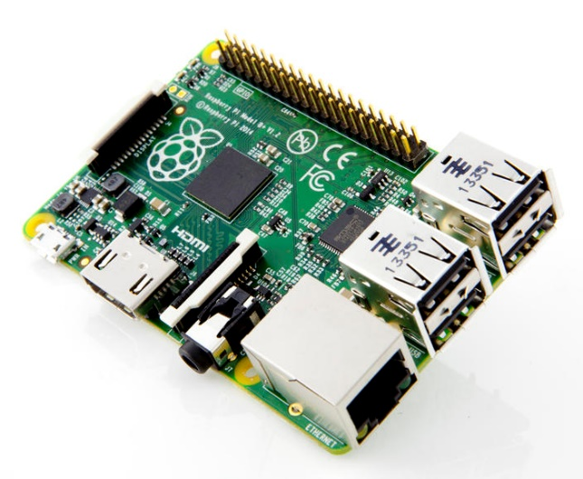
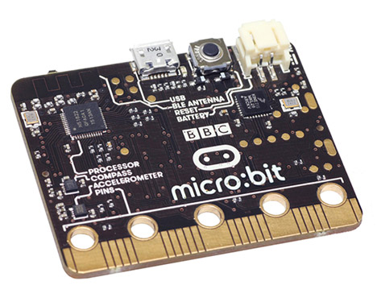
Microcontrollers
Affordable, small and easy to program microcontrollers have become popular recently.
Arduino, Raspberry Pi and the BBC Micro:Bit.
Wide range of applications – robotics, wearables, home automation

Slide 4
Your challenge
Program controls for the school robot arm in python and use them to lift stuff into a container.
Go log in.

